Slide 1
Droughts vs Election Results
A visual exploration
Notes:
Background
I live in Saxony which is and has historically been the most right-wing region of Germany. It is also home to many climate change deniers.
Saxony has suffered from severe droughts every year since 2018
This year there have already been two incidents of wildfires in nearby regions which affected the air quality in Dresden, the capital of Saxony
I can actually smell the scent of wildfire while I am giving this presentation
The experience of living in Saxony for 9 years has led me to the following research question: Is there a connection between an increase in droughts and the way people vote? Can we build a hypothesis by visualising historic data on droughts and election results?
For the purposes of this project I will take a closer look at available data from Germany (1952- 2022) and the United States (2000-2016).
Since data from the United states is more readily available in processable formats there is a possibility that this analysis will only apply for the United States. The biggest challenge of this project is to match available data on drought to national voting districts. And to plot this on a filled map.

Slide 2
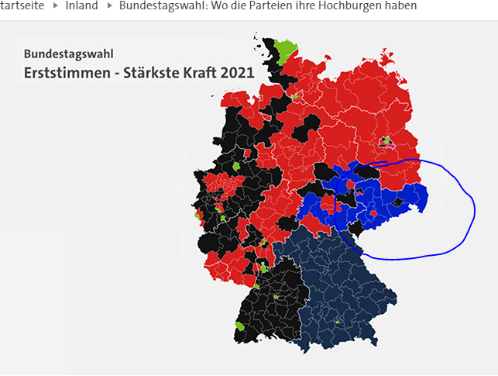

Slide 3
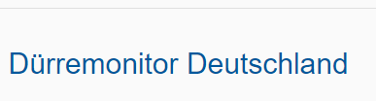
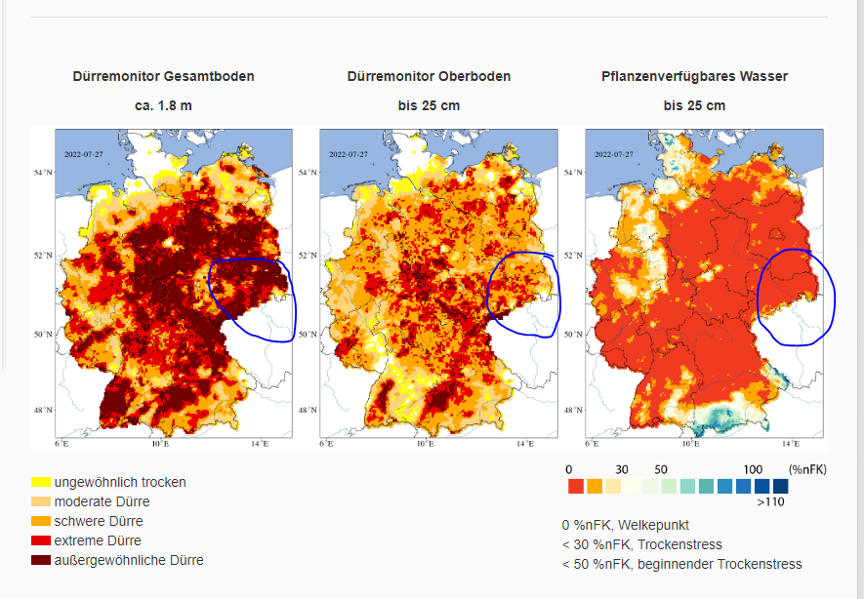

Slide 4
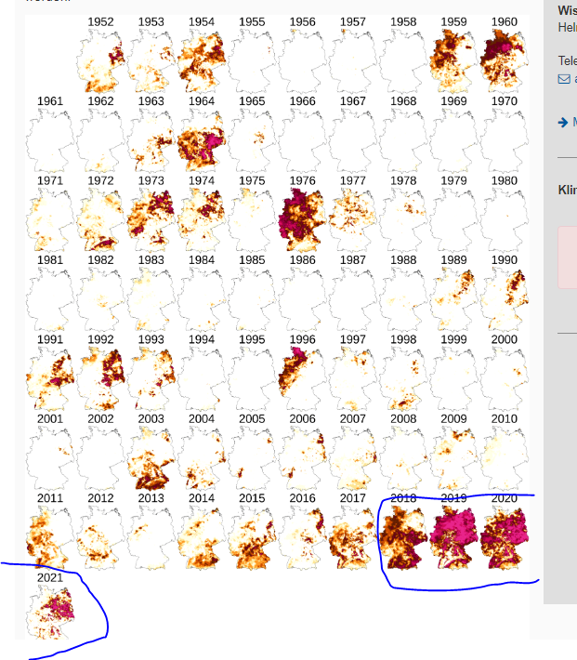

Slide 5
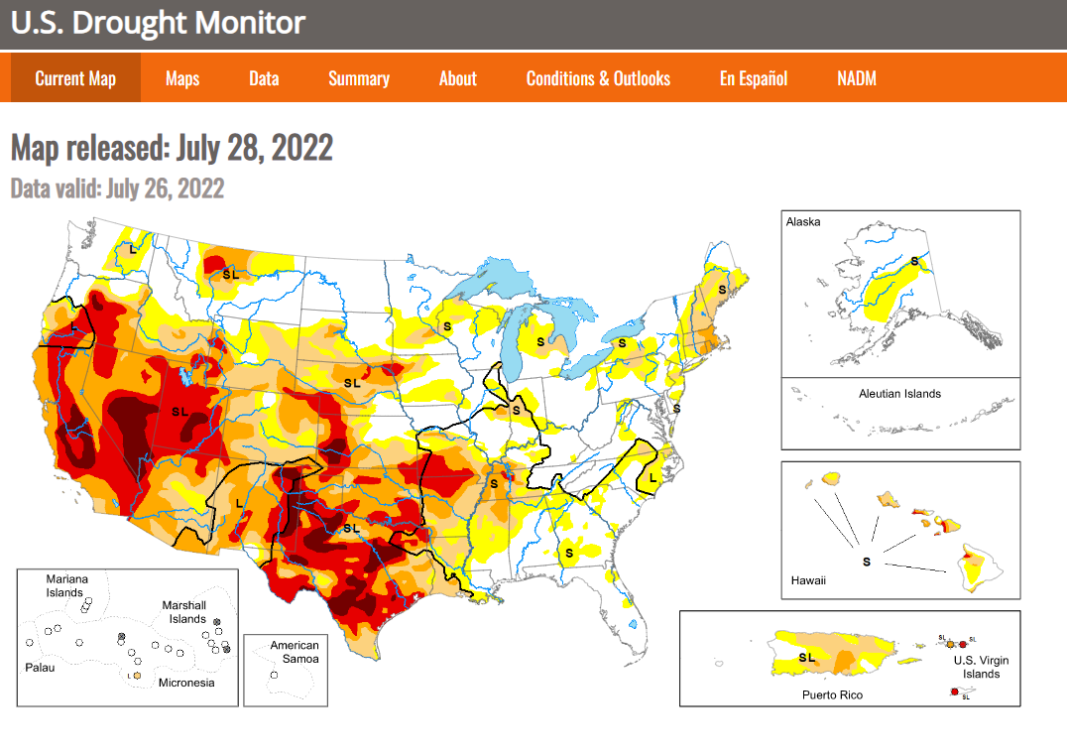

Slide 6
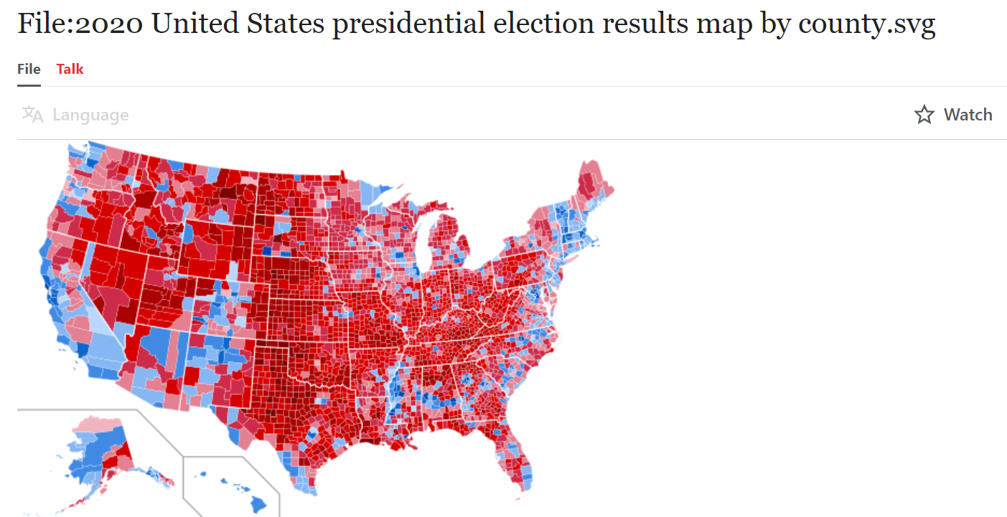

Slide 7
Status Quo

Slide 8
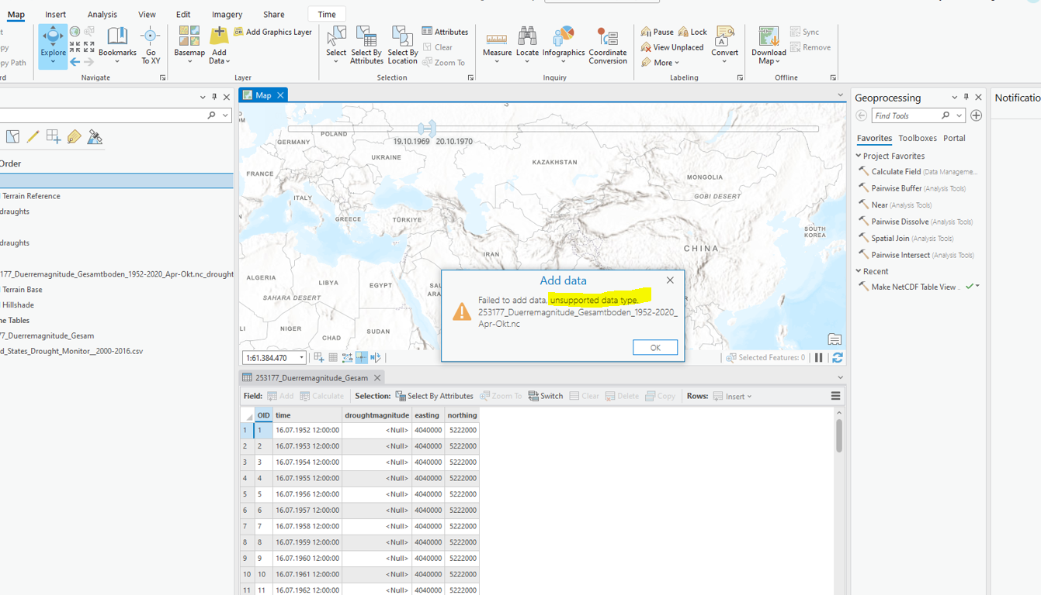

Slide 9
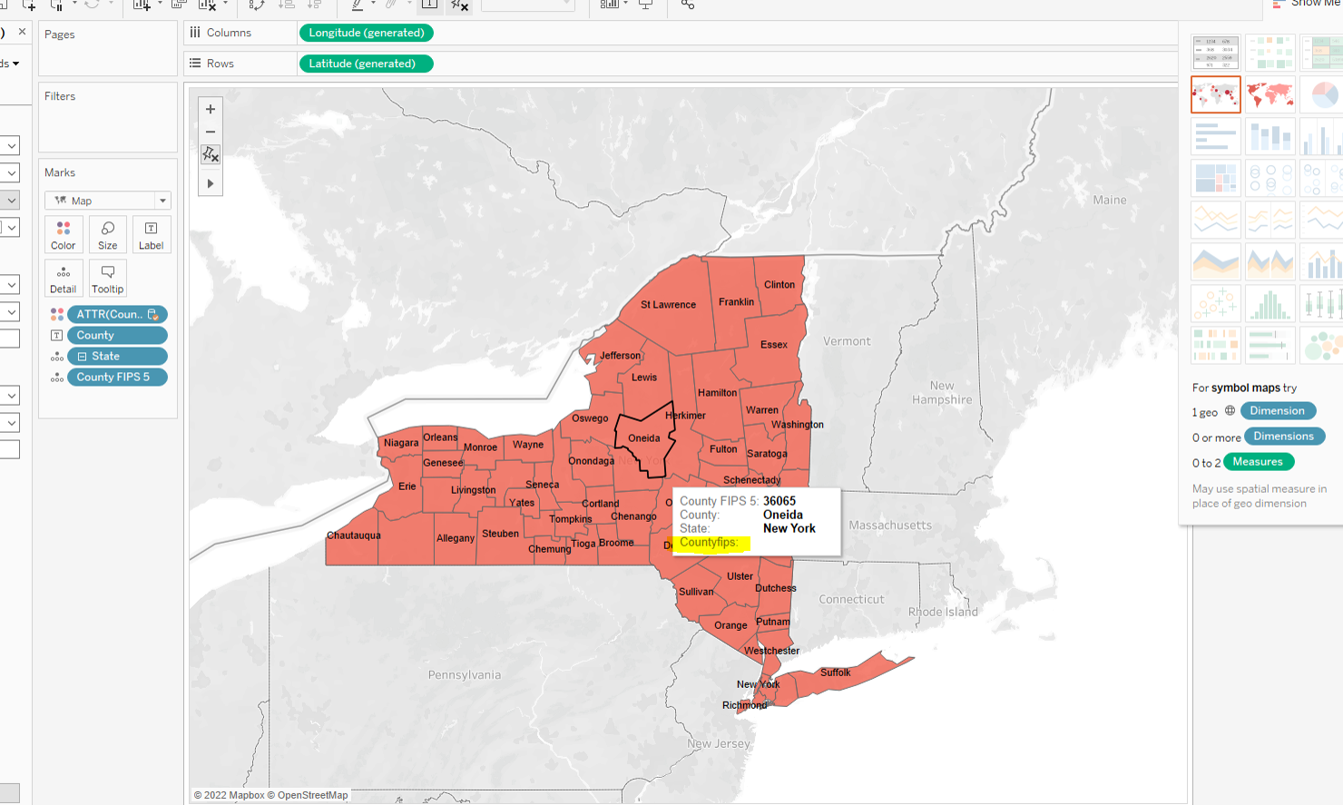

Slide 10
Further Elaborations
Search for further available data to add to the maps of Germany and the USA (wildfires, extend time periods of observation, etc.)
Plot project in different working environments (tableau, PowerBI, python)
Deploy project to Streamlit if possible
Conclude if visual exploration gives hints for the formulation of a hypothesis (Correlation between droughts and changes in voting patterns) or for further exploration

